Slide 1

IS480 Acceptance
ReFokus 2.0

Slide 2
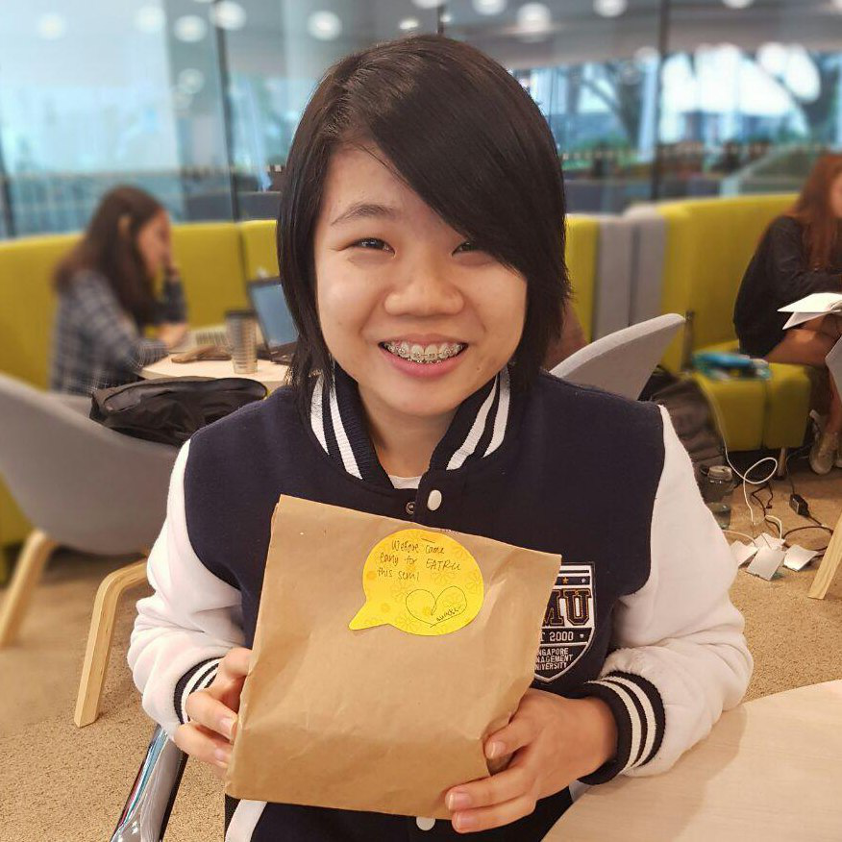
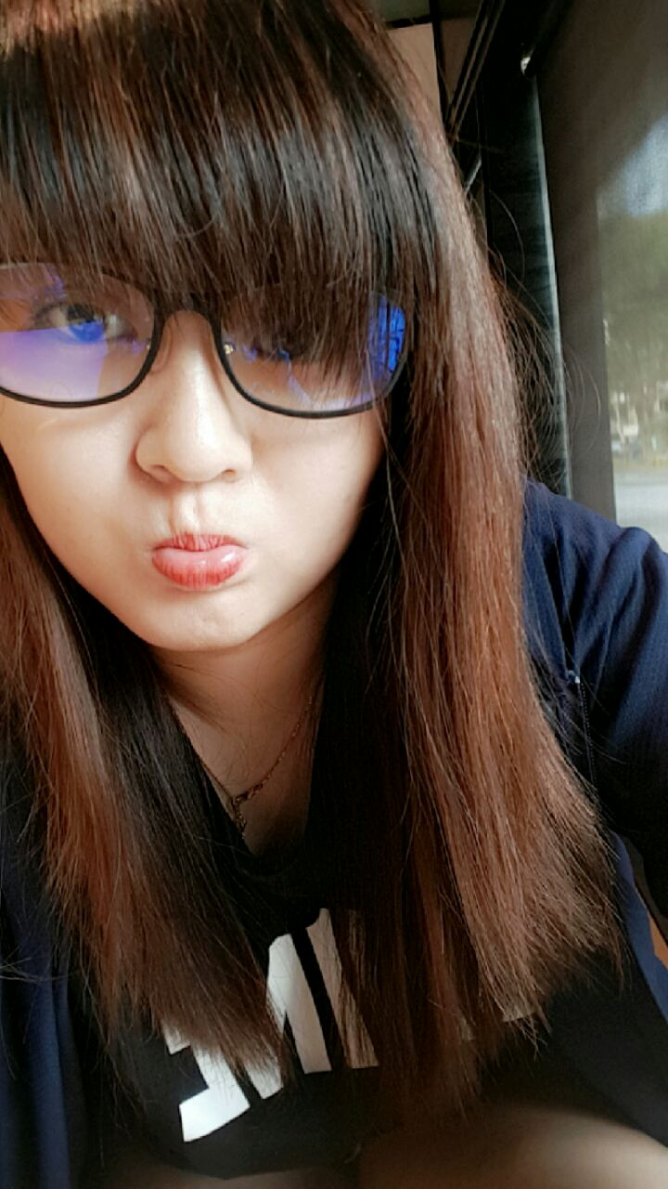
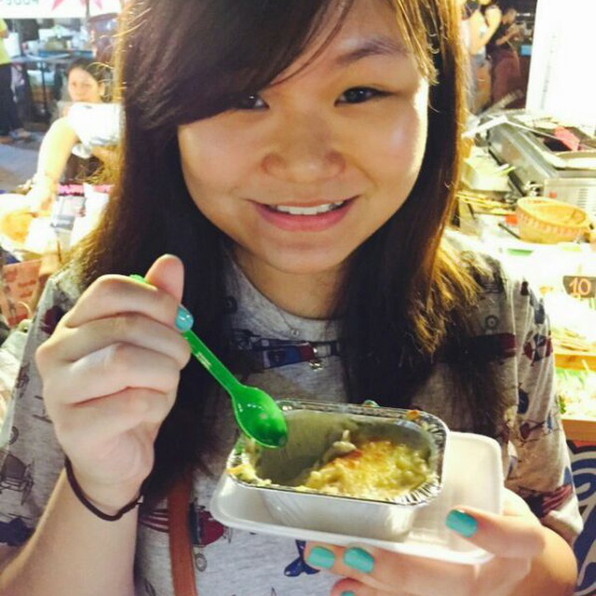

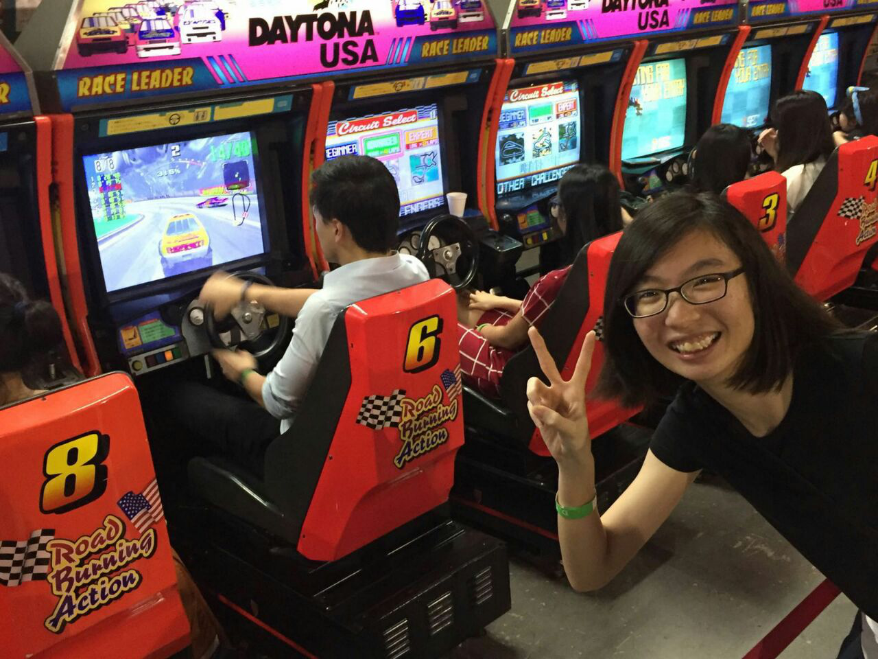
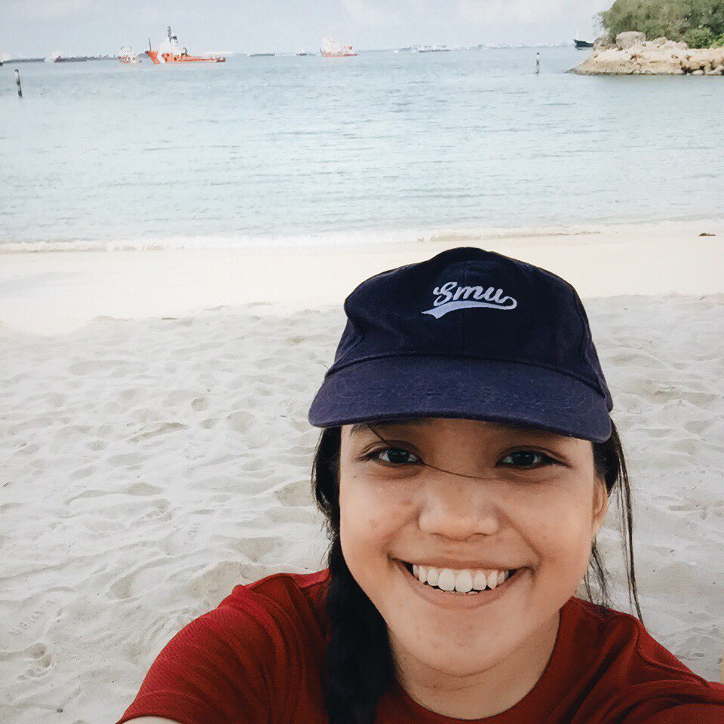
The Team
Lay Ting
Lead Developer
Sin Kin
Front End Developer
Yi Ru
Business Analyst
Main backend developer for web portal
Assists with project management
Main UI/UX designer responsible for ensuring the usability of web and mobile app
Assists business analyst with market research
In charge of mapping user requirements to technical requirements and vice versa
Assists with quality assurance and testing
Marilyn
Quality Assurance Manager
Dawn
Project Manager
Accountable for quality of systems and
Assists with mainly mobile back-end development
Responsible for overall project progress and deliverables
Assists with web front-end design

Slide 3
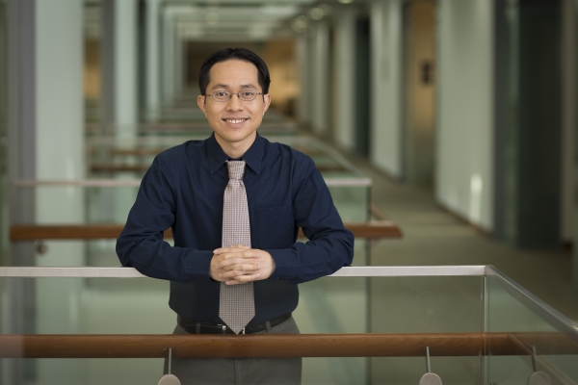
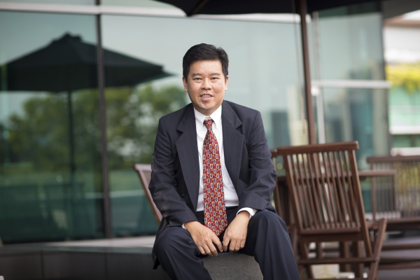
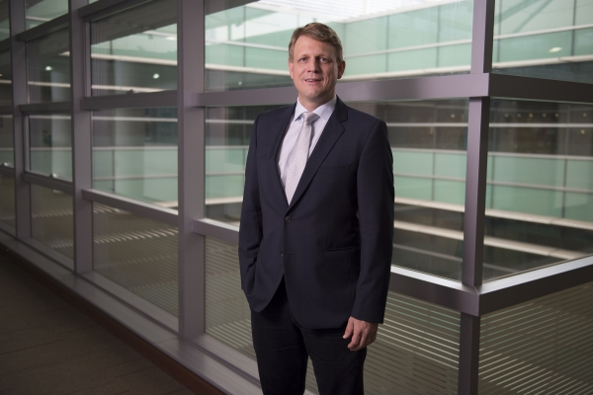
Sponsors & Supervisor
Prof. Jochen Reb
Prof. William Tov
Prof. Benjamin Gan

Slide 4
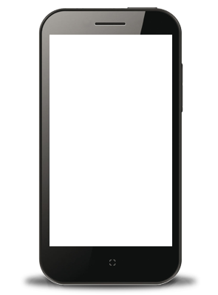
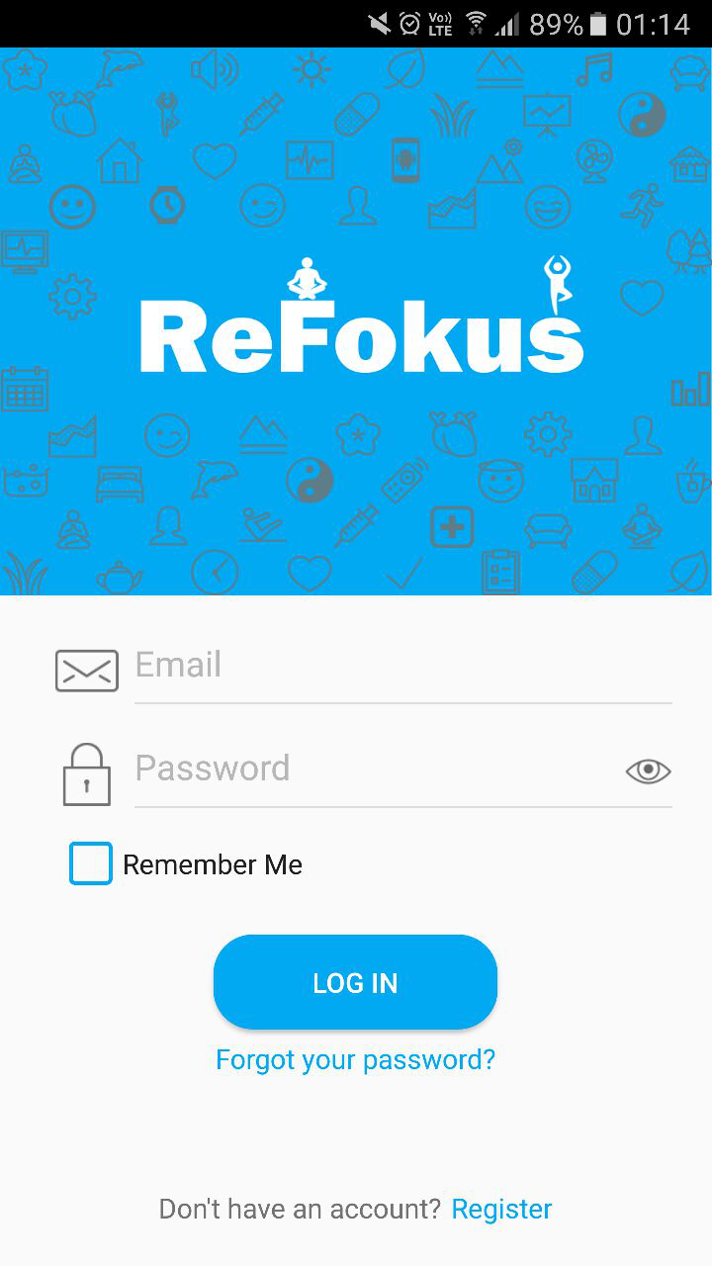

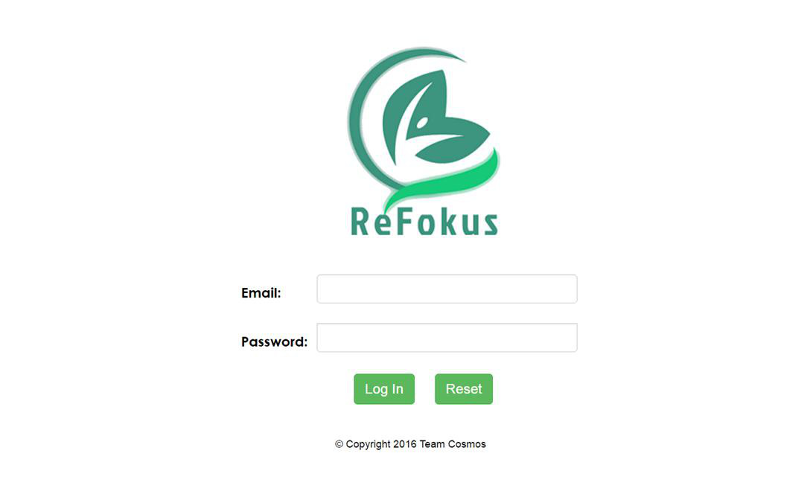
PROJECT INTRO
ABOUT REFOKUS
Mindfulness Meditation Initiative
Meditation App & Researcher Web Portal (From Team Vulcan)
Promote a positive difference
Extend outreach
Facilitate the research studies
OBJECTIVES
4
Notes:
The initiative aims to promote mindfulness through meditation exercises, education on the initiative and a wider outreach to android mobile users through refocus
We are refining work from Team Vulcan, through bug fixing. We are also adding value to the current system by introducing the feedback module (new), modifying survey generation and smart wearable module

Slide 5
TARGET USERS
RESEARCHERS
PARTICIPANTS
Notes:
We want to encourage more researchers to hop onto the web portal to carry out various research studies relating to the mindfulness initiative
At the same time, we also want increase usage of the mobile app to allow researchers to increase their studies

Slide 6

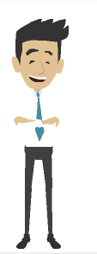
PERSONAS
ABIGAIL, AGE: 22
TONY, AGE: 36
Year 3 SMU Info Systems
SMU Researcher
Undergraduate who is struggling to cope with stress from her final-year project
Used the ReFokus mobile app before but current features do not entice her to use it regularly
Active researcher of 6 years studying the mental wellbeing of people and its relation to mindfulness
Particularly interested in the area of meditation
Notes:
Abigail, one of the few mobile users
Tony, researcher who has iterests in studying the effects of meditation

Slide 7
STORYBOARD

Slide 8
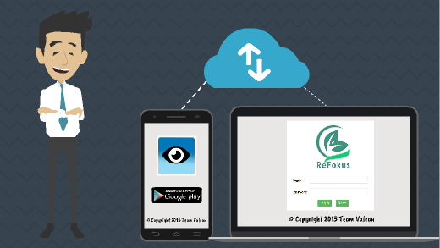

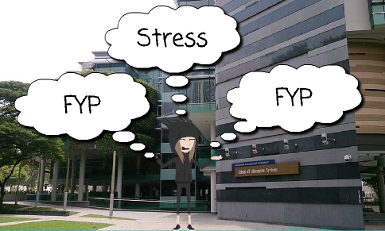
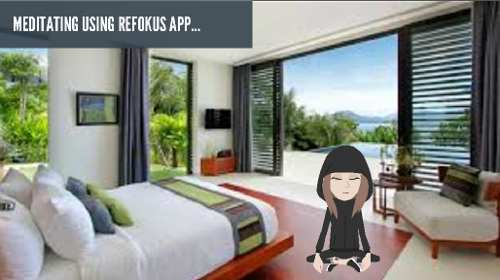
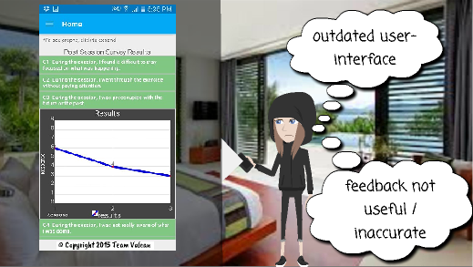

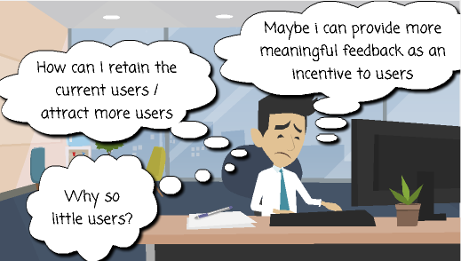
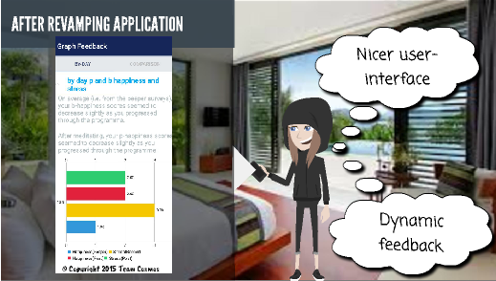
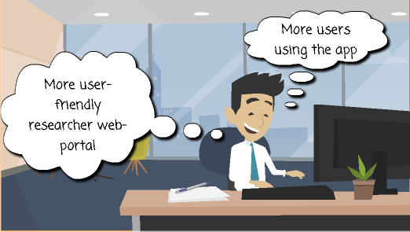

Slide 9
PROJECT VALUE

Slide 10
PROBLEM
SOLUTION
GOALS
Inflexible Functions for Researchers
Survey Generation Module
Improve Flexibility for Researchers
Data management
Insufficient Pool of Research Subjects
Increase Pool of Research Subjects
Preview Module
Feedback Module
Reduce Potential of Data Loss
Potential Data Loss
User Module
Smartwatch Module
Improve Accuracy of Materials/Data Collected
Anomalies Not Accounted For
Interruption Module
Notes:
Compare with Vulcan’s + BA on smart watch

Slide 11
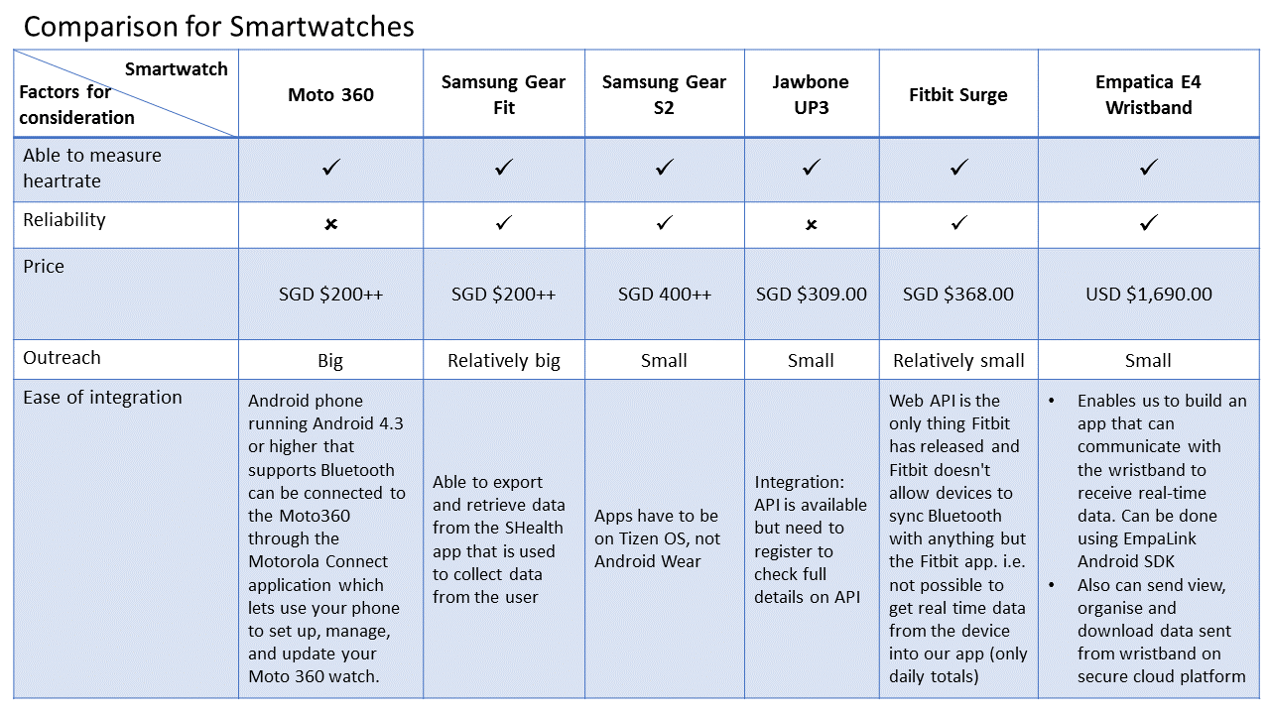
Smart Wearable Market Comparison

Slide 12
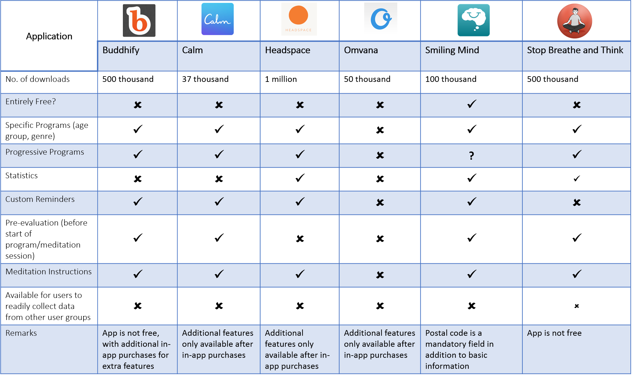
Meditation Apps Market Comparison

Slide 13
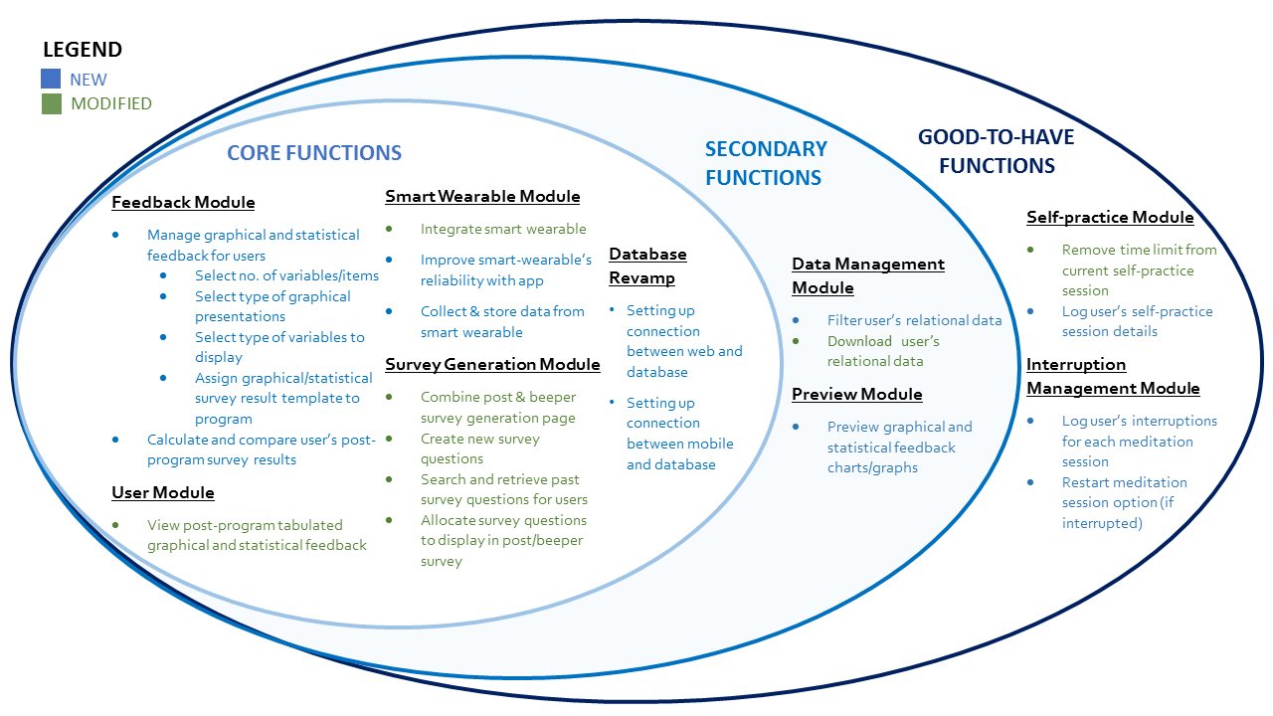
Scope
Notes:
Gold star indicates new function added from proposal stage
Green star indicates shift of function

Slide 14
DEMO

Slide 15
PROJECT PLAN

Slide 16
Timeline
User Testing #1
User Testing #2
Alpha Launch to PlayStore
User Testing #4
Beta Launch to PlayStore/ Pilot Study
21 -30 Nov Finals
User Testing #3
15 June Proposal
17 Aug Acceptance
3-7 Oct Midterms
7 Nov Poster Submission
2 Dec Poster Day
1
2
3
4
5
6
7
8
9
10
11
12
13
14
15
16
1 Apr
3 May
26 May
11 June
3 July
19 July
2 Aug
16 Aug
30 Aug
13 Sep
27 Sep
7 Oct
21 Oct
4 Nov
14 Nov
21 Nov
Iteration 1
1st Apr – 2nd May
(32 days)
Iteration 3
26th May – 10th June
(16 days)
Iteration 5
3rd July – 18th July
(16 days)
Iteration 7
2nd Aug – 15th Aug
(14 days)
Iteration 9
30th Aug – 12th Sep
(14 days)
Iteration 11
27th Sep – 6th Oct
(10 days)
Iteration 13
21st Oct – 3rd Nov
(14 days)
Iteration 15
14th Nov – 20th Nov
(7 days)
Requirement gathering
Plan deliverables
Finals hiatus
First sponsor meeting preparation
First sponsor meeting
Research & learn android app development
Set up database
Connect to database
Debugging for User Testing #1
Debugging for User Testing #2
Deployment
Smart Wearable Module
Integrate smart wearable
Collect & store data from smart wearable
Debugging for User Testing #3
Integration, testing & debugging
Deployment
Interruption Management Module
Log user’s interruptions for each meditation session
Restart meditation session option (if interrupted)
Final Integration, testing & debugging
Final deployment
Feedback module (#1)
Select no. of variables/items
Select type of graphical presentations
Select type of variables to display
Assign to program
Discussion and implementation of change requests
Acceptance preparation
Update relevant design documents
Integration, testing & debugging
Deployment
Integration, testing & debugging
Deployment
Discussion and implementation of change requests
Update relevant design documents
Integration, testing & debugging
Deployment
Integration, testing & debugging
Deployment
UAT #1 preparation
Update relevant design documents
Market research
Prototyping of web portal and mobile app
Iteration 2
3rd May - 25thMay
(23 days)
Iteration 4
11th June – 2nd July
(22 days)
Iteration 6
19th July – 1st Aug
(14 days)
Iteration 8
16th Aug – 29th Aug
(14 days)
Iteration 10
13th Sep – 26th Sep
(14 days)
Iteration 12
7th Oct – 20th Oct
(14 days)
Iteration 14
4th Nov – 13th Nov
(10 days)
Iteration 16
21st Nov – 2nd Dec
(12 days)
Review / test team Vulcan’s work (previous team)
Plan iterations/ schedule
Research & learn about hardware integration
Feedback Module (#2)
Calculate and compare user’s post-program survey results
User Module
View post-program tabulated graphical and statistical feedback
Implementation of change requests
Preview Module
Preview graphical and statistical feedback charts/graphs
Data Management Module
Filter user’s relational data
Download user’s relational data
Self-practice Module
Remove time limit from current self-practice session
Log user’s self-practice session detail
Final Integration
Debugging for User Testing #4
Final Deployment
Poster day preparation
Final presentation preparation
Survey Generation Module
Combine post & beeper survey generation page
Create new survey questions
Search and retrieve past survey questions for users
Allocate survey questions to display in post/beeper survey
Database Revamp
Database redesign
Change relevant DAO
Establish connection between mobile & web app
Integration, testing & debugging
Deployment
Integration, testing & debugging
Deployment
Integration, testing & debugging
Deployment
Poster submission preparation
Integration, testing & debugging
Deployment
Update relevant design documents
Update relevant design documents
LEGEND
Market research
Update relevant design documents
Iteration
Others
Integration, testing, debugging & deployment
Core
General
Secondary
Milestone
Mobile Platform Deployment
Integration, testing & debugging
Deployment
Good-to-have
User Testing
Notes:
Gold star indicates new function added from proposal stage
Green star indicates shift of function

Slide 17
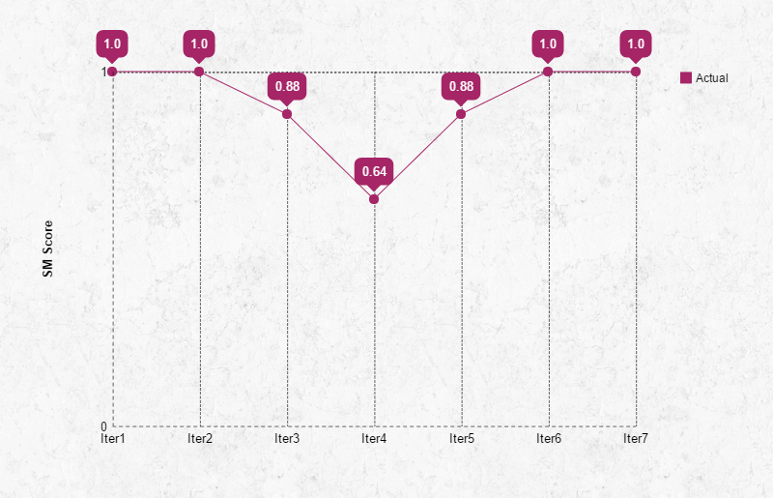
Schedule Metrics

Slide 19
USER TESTING

Slide 20

USER TESTING
Objectives of UT #2
Get feedback on usability of Researcher Web Portal and Refokus Mobile App
Identify areas for improvement based on UT results
Demographics of Users
1 Researcher
4 Students

Slide 21

User Testing #2
CLAIM #1:
75% of our users are satisfied (i.e. 4/5 satisfaction rating) with our Researcher Web Portal
General Comments
The interface is clean and simple
Difficult to find the programs that were created; too much info were shown
Re-population of fields could be done for convenience
Navigations are straightforward
More icons could be used to improve user-friendliness
2 out of 5 users (40%) were satisfied with our Researcher Web Portal
2.9/5
Overall Satisfaction
Researcher Web Portal

Slide 22
User Testing #2
CLAIM #2:
75% of users are satisfied (i.e. 4/5 satisfaction rating) with the user experience of our ReFokus Mobile App
General Comments
The interface is clean, simple and colourful
Naming conventions could be improved
Font size can be increased for better visibility
2.9/5
3 out of 5 users (60%) were satisfied with our ReFokus Mobile App
Overall Satisfaction
ReFokus Mobile App

Slide 23
User Testing #2
CLAIM #3:
75% of users can create and activate a program with 1 survey question, 1 comparison graph and one by-day graph within 1.5x expert clicks (55 clicks).
3 out of 5 users (60%) took less than 55 clicks to create and activate a program and upload a podcast in our Researcher Portal
General Comments
Re-population of fields could be done for convenience
3/5 users
55 clicks
Researcher Web Portal

Slide 24
User Testing #2
CLAIM #4:
75% of users are able to see meditation feedback (one by-day and one comparison) in our ReFokus Mobile App within 10 clicks
3 out of 5 users (60%) took less than 10 clicks to get to their meditation feedback (one by-day graph and one comparison graph)
General Comments
Easy to navigate through the app; intuitive enough for user
3/5 users
10 clicks
ReFokus Mobile App

Slide 25
Top 3 Risks
Ranking | Risks | Impact | Likelihood | Category | Mitigation Steps
1 | Delaying of schedule due to unavailability of members (i.e. falling sick) | High | High | A | Everyone takes on double role to cover the absence of any particular member.
2 | Unable to meet client’s expectations due to dichotomous perspective of functionalities | High | Medium | A | Meet sponsor an iteration before each milestone to gather feedback. Improve and adjust functions based sponsor’s feedback.
3 | Miscommunication / misunderstanding within team | Medium | Medium | B | Document every meeting minutes and have another member to vet. Every meeting minute will have a to-do-list with the person-in-charge.

Slide 26
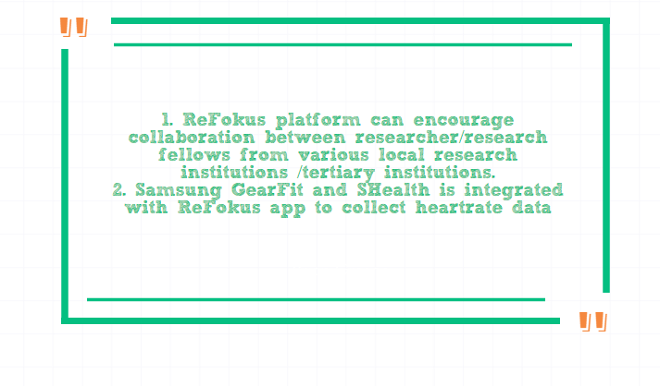
X-Factor

Slide 27
Learning Outcomes
Sin Kin
Yi Ru
I want to nurture my skills and interest in front-end development by developing user interfaces that are user-friendly yet technically feasible. I strive to enhance my communication skills through engaging with internal and external stakeholders, and propose effective solutions that can facilitate changing business needs by recognizing its impacts.
Lay Ting
Through our project, I wish to enhance my communication skills with my project teammates, hope to learn new technical skills and be able to understand the underlying mechanism of integration between hardware and software components and applications. Furthermore, I hope to provide satisfaction in planning and implementing quality and effective testing frameworks for the application.
I would like to learn how to build an application which is scalable and efficient enough to collect data from the large population of users for the researchers. I also want to be able to ensure that the application is ready to be launch and compete in the market by striving to achieve a great user experience through incorporating the best practice in this project.
Marilyn
I hope to value-add our stakeholders by gaining better understanding of my competence and manage their expectations. I also want to become a better team player by contributing good ideas and listening to my teammates’ opinions. Lastly, I hope I will be able to acquire better interpersonal skills on top of the technological knowledge through the FYP journey.
Dawn
I hope to stimulate the creativity of the team and deliver an app that is aligned with the goals of the Mindfulness Initiative and is satisfactory to our sponsor. I would like to hone my interpersonal skills in face of ambiguity and challenges, as well as become more experienced in seeing a project through delivery in such circumstances.

Slide 28
 Thank You!

Slide 29
APPENDIX

Slide 30
Database Revamps

Slide 31
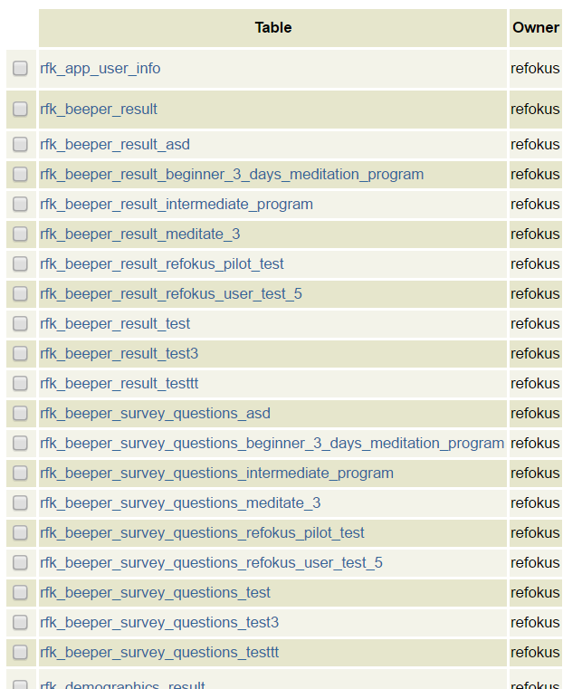
Old Database – refokus database tables

Slide 32
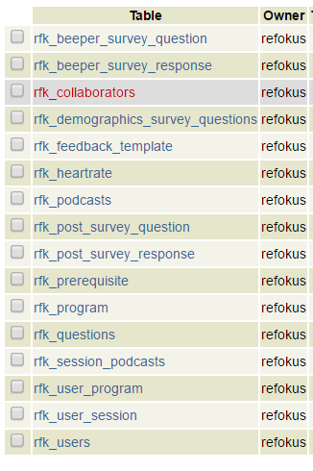
New Database - refokus database tables

Slide 33
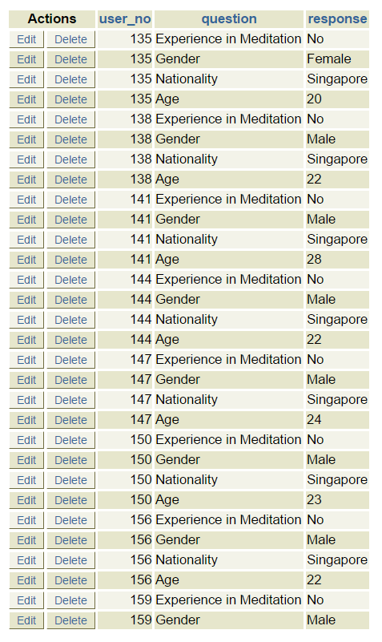
Old Database – refokus database tables
rfk_demographics_result

Slide 34
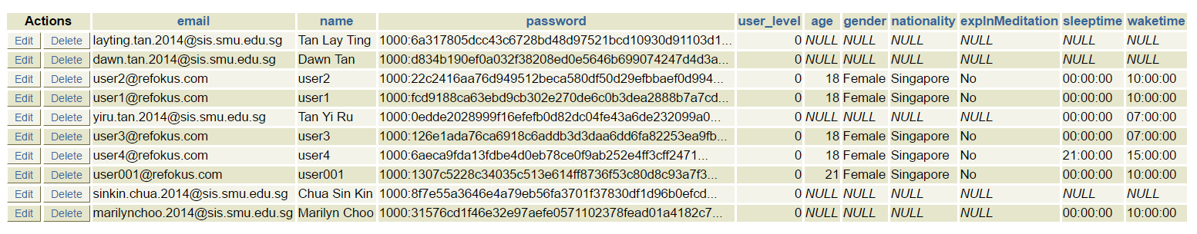
New Database – refokus database tables
rfk_users

